Slide 1
Neural networks and deep learning
Presented by: Nadimpalli Akhilesh Kumar Dutt(1BM19CS092)
Under the guidance of: Sunayana S
(Assistant Professor, BMSCE)

Slide 2
Topics Covered/learned
Introduction to Deep Learning
Real World Applications of Deep Learning
Deep Learning VS Machine Learning
What are Neural Networks?
Different types of Neural Networks
Logistic Regression
Real World Applications of Logistic Regression
Use of Gradient Descent Algorithm
Gradient Descent Algorithm in Deep Learning
Importance of Gradient Descent

Slide 3
INTRODUCTION TO DEEP LEARNING
Deep learning can be considered as a subset of machine learning. It is a field that is based on learning and improving on its own by examining computer algorithms.
Deep learning drives many artificial intelligence applications and services that improve automation, performing analytical and physical tasks without human intervention.
Deep learning technology lies behind everyday products and services (such as digital assistants, voice-enabled TV remotes, and credit card fraud detection) as well as emerging technologies (such as self-driving cars).
Most people encounter deep learning every day when they browse the internet or use their mobile phones. Among countless other applications, deep learning is used to generate captions for YouTube videos, performs speech recognition on phones and smart speakers, provides facial recognition for photographs.

Slide 4
Real world applications of DEEP LEARNING
Self-driving cars
Natural Language Processing and Speech Recognition
Computer Vision
Machine Translation
Medical Image Analysis
Video Games
Big Data and Data Mining
Online Self-Service Solutions

Slide 5
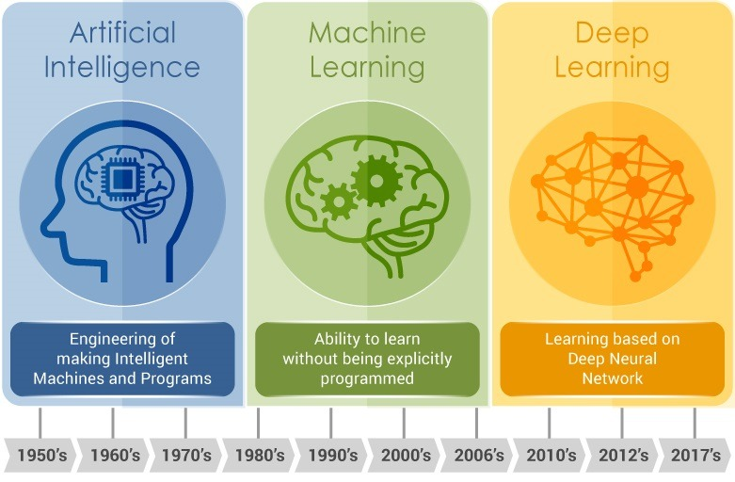

Slide 6
DEEP LEARNING VS MACHINE LEARNING
Machine Learning: Machine learning is a subset, an application of Artificial Intelligence (AI) that offers the ability to the system to learn and improve from experience without being programmed to that level. Machine Learning uses data to train and find accurate results. Machine learning focuses on the development of a computer program that accesses the data and uses it to learn from itself.
Deep Learning: Deep Learning is a subset of Machine Learning where the artificial neural network and the recurrent neural network come in relation. The algorithms are created exactly just like machine learning but it consists of many more levels of algorithms. All these networks of the algorithm are together called the artificial neural network. In much simpler terms, it replicates just like the human brain as all the neural networks are connected in the brain, which exactly is the concept of deep learning. It solves all the complex problems with the help of algorithms and its process.

Slide 7
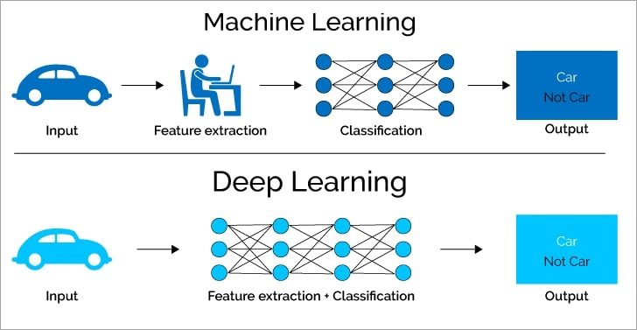

Slide 8
WHAT are neural networks?
A neural network is a series of algorithms that endeavours to recognize underlying relationships in a set of data through a process that mimics the way the human brain operates. In this sense, neural networks refer to systems of neurons, either organic or artificial in nature.
Neural networks, also known as artificial neural networks (ANNs) or simulated neural networks (SNNs), are a subset of machine learning and are at the heart of deep learning algorithms.
They are used in a variety of applications in financial services, from forecasting and marketing research to fraud detection and risk assessment.
Neural networks with several process layers are known as deep networks and are used for deep learning algorithms.

Slide 9
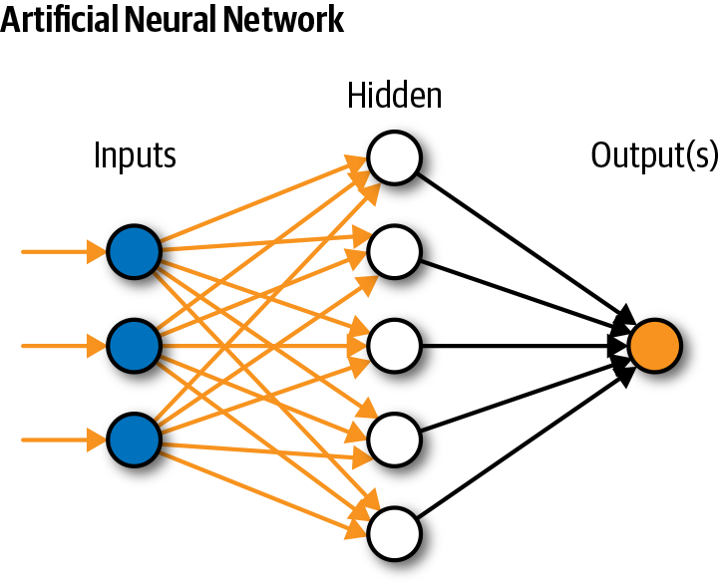

Slide 10
TYPES OF NEURAL NETWORKS
Perceptron
Feed Forward Neural Networks
Convolutional Neural Network

Slide 11
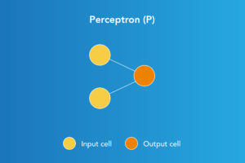
Perceptron
Perceptron model is one of the simplest and oldest models of Neuron. It is the smallest unit of neural network that does certain computations to detect features or business intelligence in the input data. It accepts weighted inputs, and apply the activation function to obtain the output as the final result. Perceptron is also known as TLU(threshold logic unit). Perceptron's can implement Logic Gates like AND, OR, or NAND and cannot implement Boolean XOR gates.

Slide 12
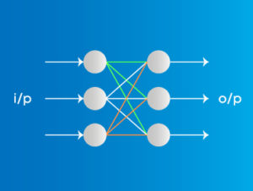
FEED FORWARD NEURAL NETWORKS
A Feed Forward Neural Network is an artificial neural network in which the connections between nodes does not form a cycle. The feed forward model is the simplest form of neural network as information is only processed in one direction. While the data may pass through multiple hidden nodes, it always moves in one direction and never backwards. It is Less complex, easy to design & maintain Fast and speedy. It is useful in Face Recognition, Computer vision, Speech Recognition.

Slide 13
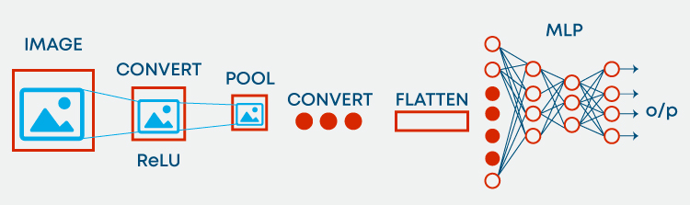
Convolutional neural networks
Convolution neural network contains a three-dimensional arrangement of neurons, instead of the standard two-dimensional array. The first layer is called a convolutional layer. Each neuron in the convolutional layer only processes the information from a small part of the visual field. Input features are taken in batch-wise like a filter. The network understands the images in parts and can compute these operations multiple times to complete the full image processing. Processing involves conversion of the image from RGB or HSI scale to grey-scale. Furthering the changes in the pixel value will help to detect the edges and images can be classified into different categories. It is used in Image Processing, Computer Vision, Speech Recognition.

Slide 14
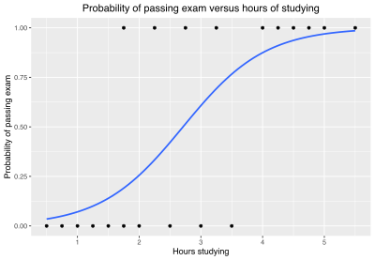
Logistic regression
Logistic regression is one of the classic machine learning methods. Logistic regression is a statistical analysis method to predict a binary outcome, such as yes or no, based on prior observations of a data set. Like all regression analyses, the logistic regression is a predictive analysis.
Logistic regression is a useful analysis method for classification problems, where you are trying to determine if a new sample fits best into a category. As aspects of cyber security are classification problems, such as attack detection, logistic regression is a useful analytic technique.
Example: Passing an exam

Slide 15
Real world applications of logistic regression
Gaming
Disease Prediction
Fraud Detection
Weather Prediction
Handwriting Recognition
Image Segmentation and Categorization
Spam Detection

Slide 16
Gradient Descent Algorithm
Gradient descent is an optimization algorithm which is commonly-used to train machine learning models and neural networks. Training data helps these models learn over time, and the cost function within gradient descent specifically acts as a barometer, gauging its accuracy with each iteration of parameter updates. Once machine learning models are optimized for accuracy, they can be powerful tools for artificial intelligence (AI) and computer science applications.

Slide 17
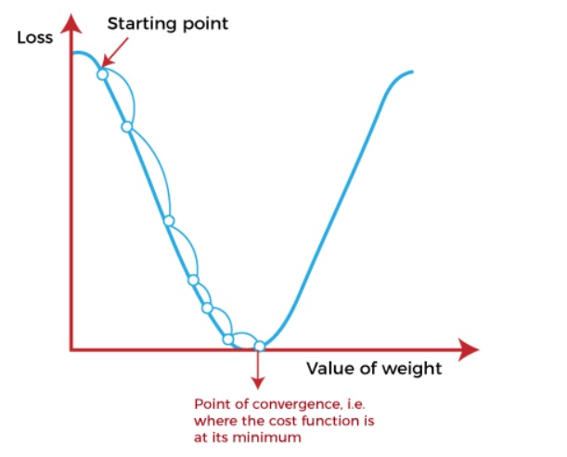
Gradient Descent in Deep learning

Slide 18
The starting point(shown in above fig.) is used to evaluate the performance as it is considered just as an arbitrary point. At this starting point, we will derive the first derivative or slope and then use a tangent line to calculate the steepness of this slope. Further, this slope will inform the updates to the parameters (weights and bias).
The slope becomes steeper at the starting point or arbitrary point, but whenever new parameters are generated, then steepness gradually reduces, and at the lowest point, it approaches the lowest point, which is called a point of convergence.
The main objective of gradient descent is to minimize the cost function or the error between expected and actual.

Slide 19
Importance of gradient descent
In machine learning, we use the gradient descent algorithm in supervised learning problems to minimize the cost function, which is a convex function (for example, the mean square error).
By using this algorithm, the machine learns by finding the best model. Remember that minimizing the cost function means finding the parameters a, b, c, etc., that give the smallest errors between our model and the y points of the dataset.
Once the cost function is minimized, this opens the door to building accurate voice recognition programs, computer vision programs, and applications to predict the stock market price.
Gradient Descent algorithm is also useful for search engines like Google and different engines like Netflix,Amazon,Youtube,etc. Based on the data collected from users, the algorithms will try to understand the interests of the internet user. This will allow them to offer relevant search results and better recommendations.

Slide 20
New learnings
What is Deep Learning,Applications,Uses?
Difference between Deep Learning and Machine Learning
Importance of Neural Networks,Benefits,Applications
Different types of Neural Networks and their uses
What is Logistic Regression,Uses,Real world applications
Gradient Descent Algorithm
Importance of Gradient Descent Algorithm in Deep Learning

Slide 21
THANK YOU

